Slide 1

Sales and Profitability Improvement for OTA
Data Analysis, Observations, and Strategic Recommendations
- Swarup Kumbhar

Slide 2
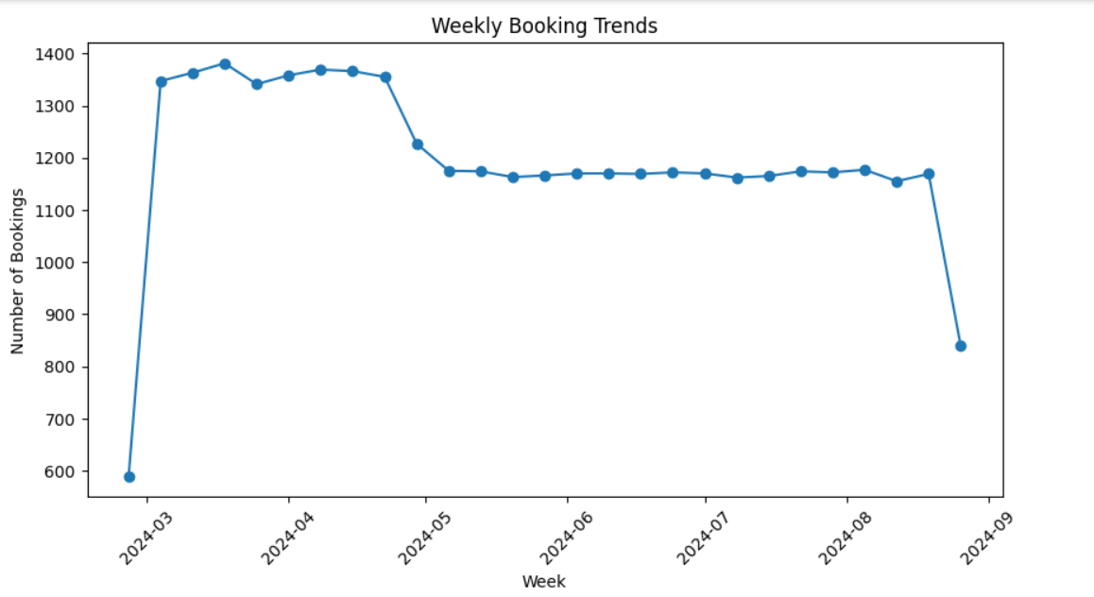
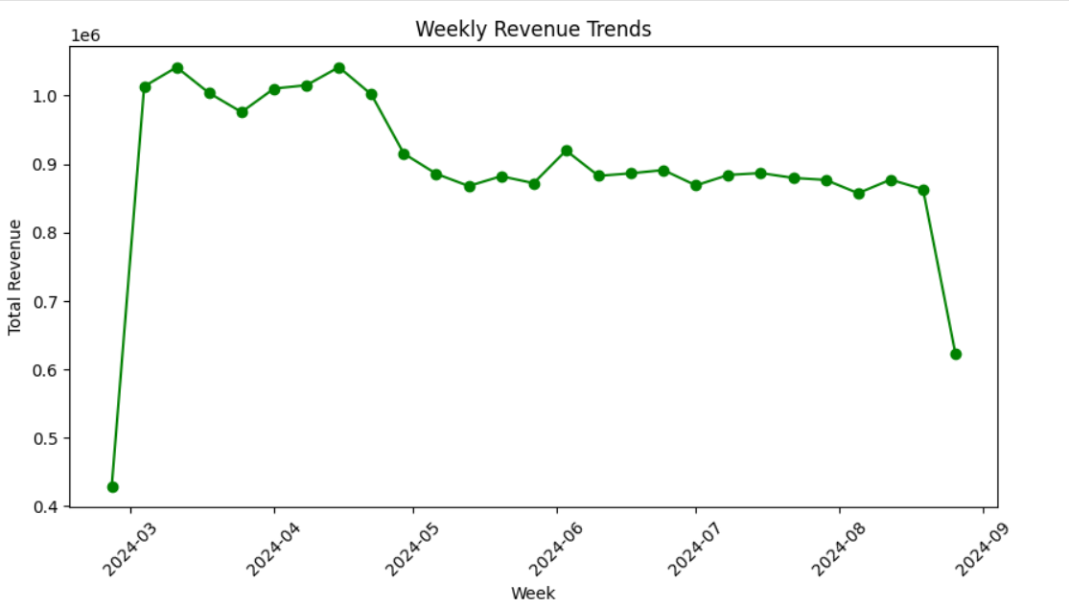
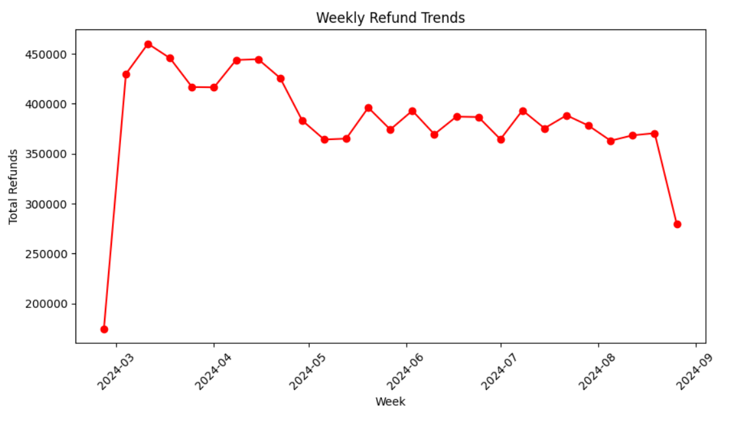
Short-Term Insights
Spike/Drop in Bookings
Short-Term Revenue Changes
Fluctuations in Refunds
Recent promotional activities, sudden changes in travel restrictions or seasonal spikes (e.g., holidays, events) could influence short-term booking fluctuations.
Bookings have decreased by 329.0 in the last week.
Revenue changes in the short term might be driven by increased demand, price adjustments, or discounts applied to attract more customers during off-peak periods.
Revenue has decreased by 240774.26 last week
Short-term changes in refunds can result from flight cancellations, rescheduling, or customer dissatisfaction due to operational issues, such as delayed or canceled flights.
Refunds have decreased by 90724.60 in last week.

Slide 3
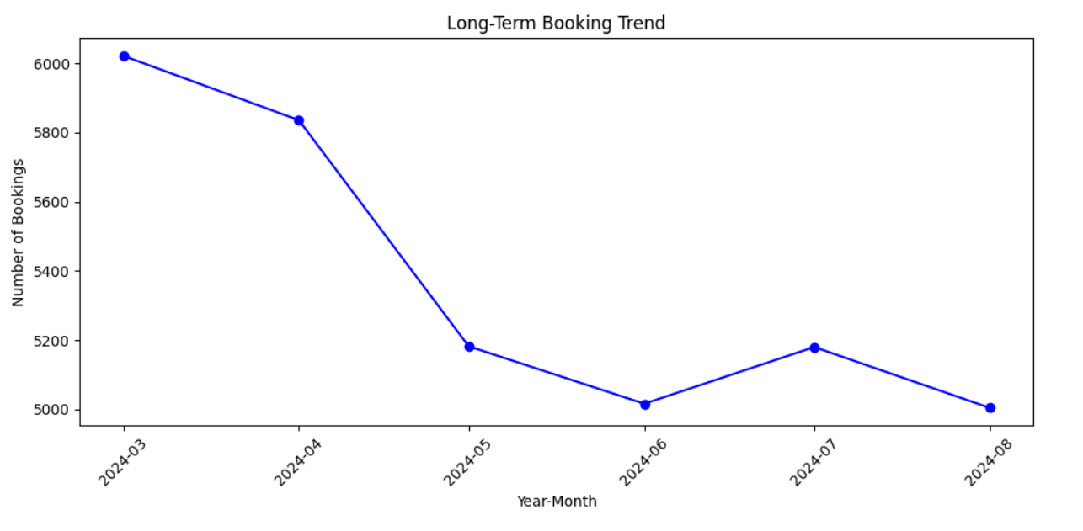
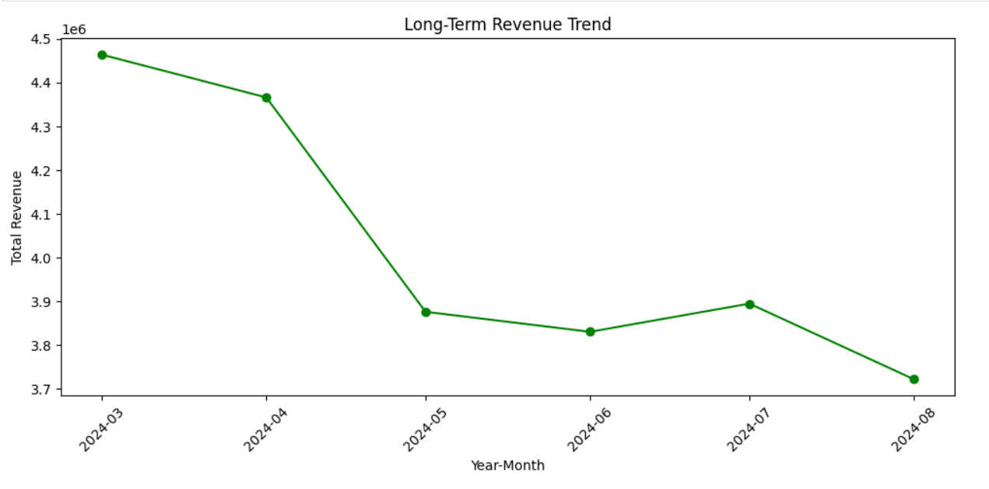
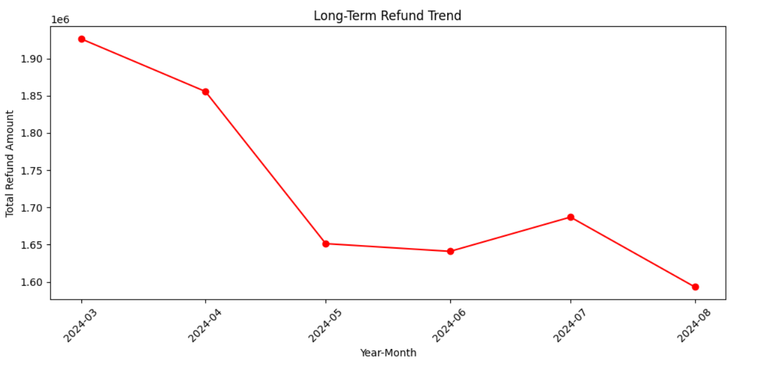
Long-Term Insights
Consistent Changes in Bookings
Revenue Trend Over Time
Long-Term Refund Patterns
Over time, sustained revenue changes could be driven by pricing strategy adjustments, evolving supplier agreements, or long-term demand shifts due to marketing campaigns or economic factors.
Gradual increase or decrease in bookings might reflect overall brand awareness, successful marketing efforts, or external factors like economic growth, emerging competitors, or global events.
Persistent growth in refunds may indicate ongoing operational challenges, such as frequent flight cancellations, supplier reliability issues, or dissatisfaction with customer service over time.

Slide 4
Analysis of Key Causes
External factors like promotions and seasonality affect short-term trends.
Long-term trends reflect pricing strategies and supplier performance.
Refund growth points to operational inefficiencies and flight disruptions.

Slide 5
Strategies to Improve Sales and Profitability
Optimize pricing with dynamic strategies.
Introduce loyalty programs to enhance customer retention.
Strengthen supplier negotiations for better margins.
Use data-driven marketing to target key segments.
Improve refund and cancellation processes.

Slide 6
Conclusion and Next Steps
Address short-term fluctuations.
Focus on long-term growth.
Implement strategic changes.

Slide 7
Questions and Answers
For any questions or doubts, feel free to reach out
Email
LinkedIn

